Slide 1

Behaviors and Processes for Maximizing Return on Investment within Threat Modeling

Slide 2
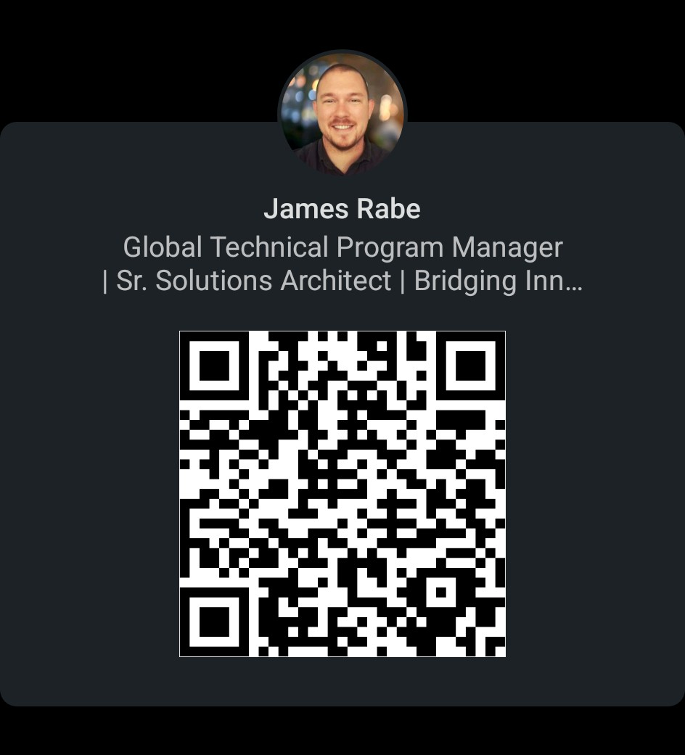

Bio
Threat Modeling, Cybersecurity
TMC - Founding Member
James Rabe
linkedin/in/jrabe3

Slide 3

Discussion Topics
What is ROI in Threat Modeling
Maximizing ROI through best in class behaviors

Slide 4

Why talk about the ROI for Threat Modeling??
Security is normally not considered a business enabler, thus we are forced to defend it.
Rented Budget Mindset - How does what I am doing contribute to the strategic initiatives of the business?
ROI enables stakeholders to defend the spend for:
Proper allocation of professionals
Proper tooling
Proper process

Slide 5
How do we measure the ROI of Threat Modeling?
VALUE -
Reduction in Security Flaws
Reduction in Time to Resolution
COSTS -
Process
Slower time to implement change
Tools / Products
ROI = (VALUE received - COST to generate value) / COST to generate value

Slide 6

How does this impact the overall ROI of the business?
ROI for the Threat Model is a function of the overall product ROI which is then a function of the business ROI
In reality, this is a weighted ROI inside of a weighted ROI, inside of a weighted ROI…
Should we actually pursue this calculation?

Slide 7
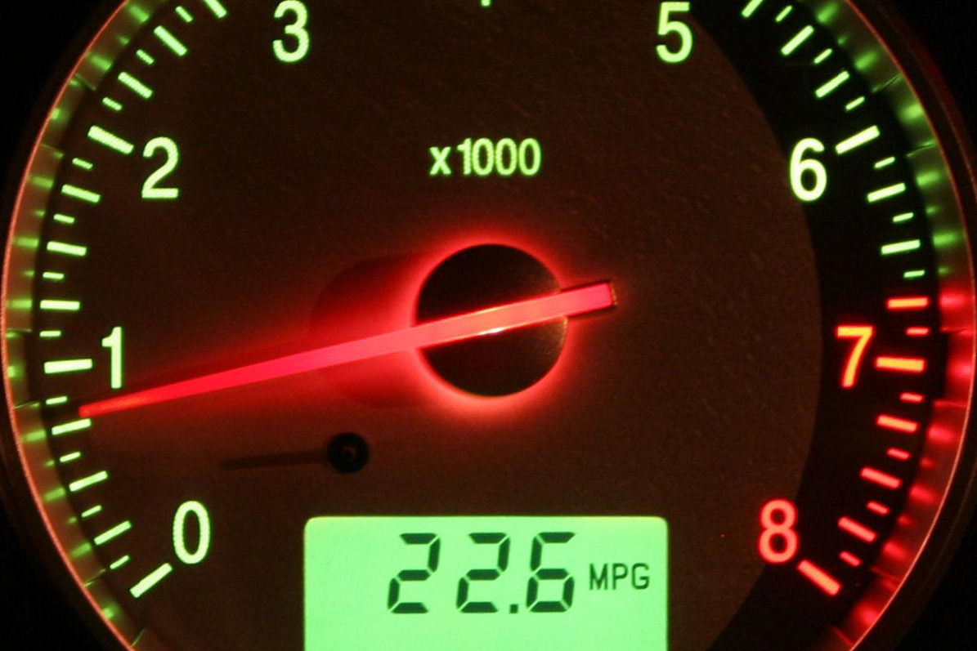
How do we maximize ROI?
INCREASE THE VALUE & DECREASE THE COSTS
Secure by design
Decrease time to resolve issues
Faster process (remove waste)
Standardized Process
Standardized tooling

Slide 8
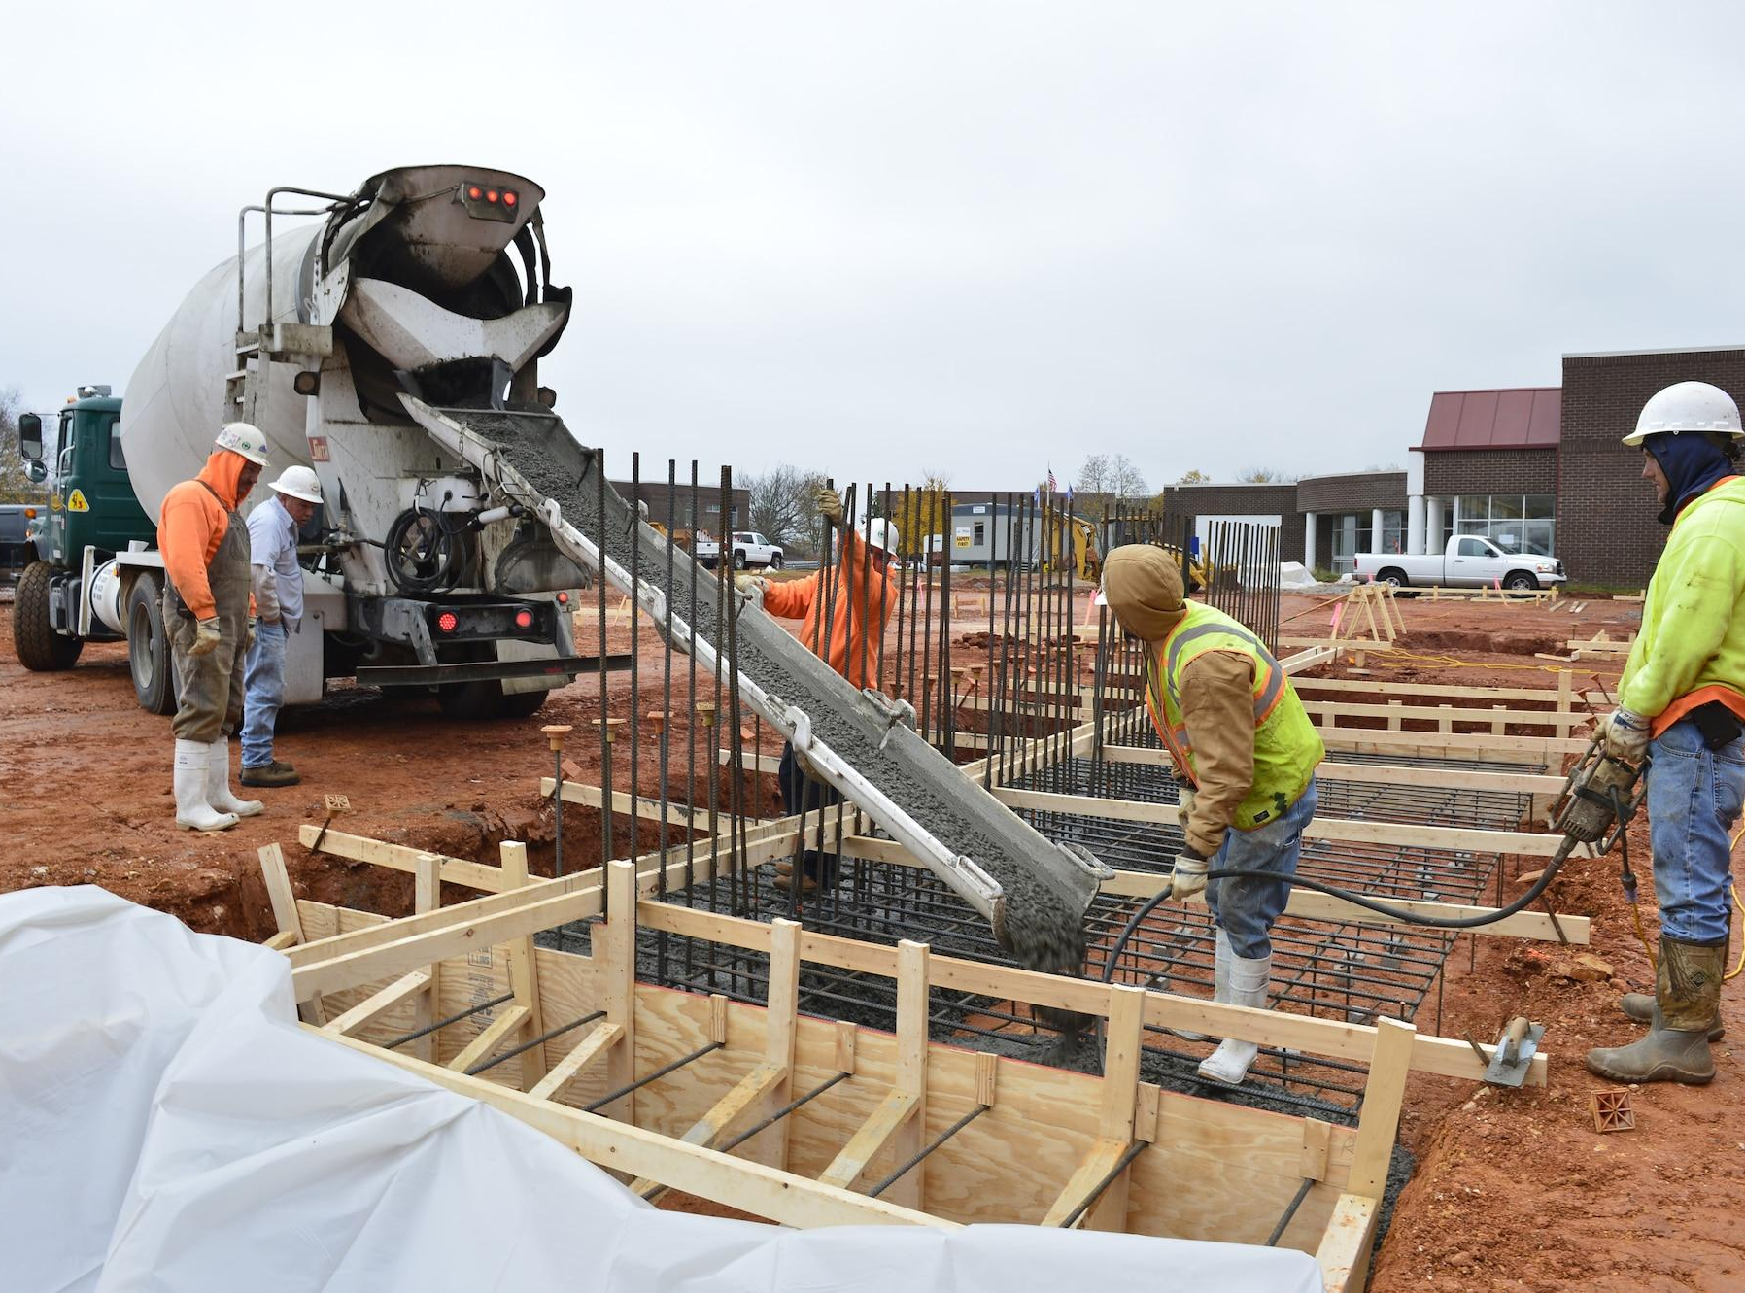
Secure by Design – Laying the foundation
Security in Context - Right sized security
Defense in Depth - Layered defense
Standardized Components
Connections - Interconnectivity + Ecosystem
Secure Code - Make secure code the easy path
Notes:
https://cheatsheetseries.owasp.org/cheatsheets/Secure_Product_Design_Cheat_Sheet.html
Some basics of secure coding include:
Input validation: Verify that all input data is valid and of the expected type, format, and length before processing it. This can help prevent attacks such as SQL injection and buffer overflows.
Error handling: Handle errors and exceptions in a secure manner, such as by logging them in a secure way and not disclosing sensitive information to an attacker.
Authentication and Authorization: Implement strong authentication and authorization mechanisms to ensure that only authorized users can access sensitive data and resources.
Cryptography: Use cryptographic functions and protocols to protect data in transit and at rest, such as HTTPS and encryption - the expected levels for a given Product Security Level can often be found by reviewing your Golden Path / Paved Road documentation.
Least privilege: Use the principle of the least privilege when writing code, such that the code and the system it runs on are given the minimum access rights necessary to perform their functions.
Secure memory management: Use high-level languages recommended in your Golden Path / Paved Road documentation or properly manage memory to prevent memory-related vulnerabilities such as buffer overflows and use-after-free.
Avoiding hardcoded secrets: Hardcoded secrets such as passwords and encryption keys should be avoided in the code and should be stored in a secure storage.
Security testing: Test the software for security vulnerabilities during development and just prior to deployment.
Auditing and reviewing the code: Regularly audit and review the code for security vulnerabilities, such as by using automated tools or having a third party review the code.
Keeping up-to-date: Keep the code up-to-date with the latest security best practices and vulnerability fixes to ensure that the software is as secure as possible.
Building an application securely can all too easily be undone if it's not securely configured. At a minimum we should ensure the following:
Bearing in mind the principle of Least Privilege: Limit the access and permissions of system components and users to the minimum required to perform their tasks.
Remembering Defense-in-Depth: Implement multiple layers of security controls to protect against a wide range of threats.
Ensuring Secure by Default: Configure systems and software to be secure by default, with minimal manual setup or configuration required.
Secure Data: Protect sensitive data, such as personal information and financial data, by encrypting it in transit and at rest. Protecting that data also means ensuring it's correctly backed up and that the data retention is set correctly for the desired Product Security Level.
Plan to have the configuration Fail Securely: Design systems to fail in a secure state, rather than exposing vulnerabilities when they malfunction.
Always use Secure Communications: Use secure protocols for communication, such as HTTPS, to protect against eavesdropping and tampering.
Perform regular updates - or leverage maintained images: Keeping software, docker images and base operating systems up-to-date with the latest security patches is an essential part of maintaining a secure system.
Have a practiced Security Incident response plan: Having a plan in place for how to respond to a security incident is essential for minimizing the damage caused by any successful attack and a crucial part of the Product Support Model.

Slide 9
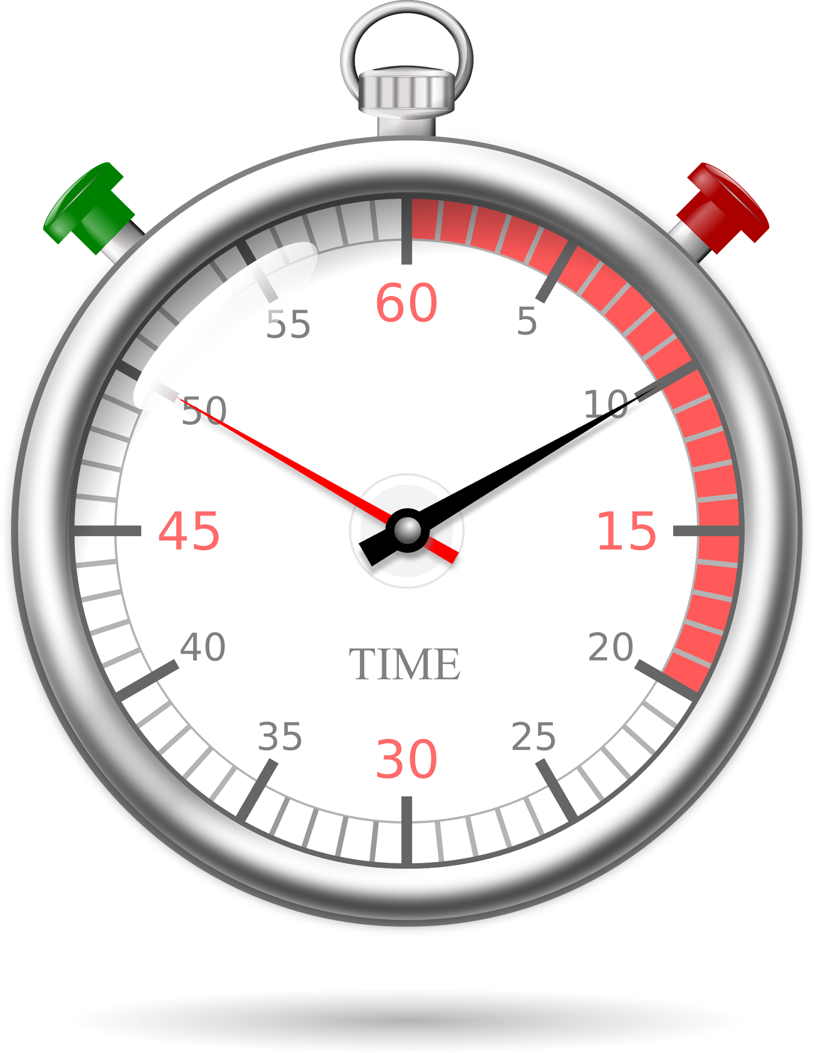
Decrease time to resolve issues
Design stage threat modeling highlights security flaws at their most cost effective point
Fixing the same flaw in production can cost 5x to 100x more than fixing it in the design phase

Slide 10
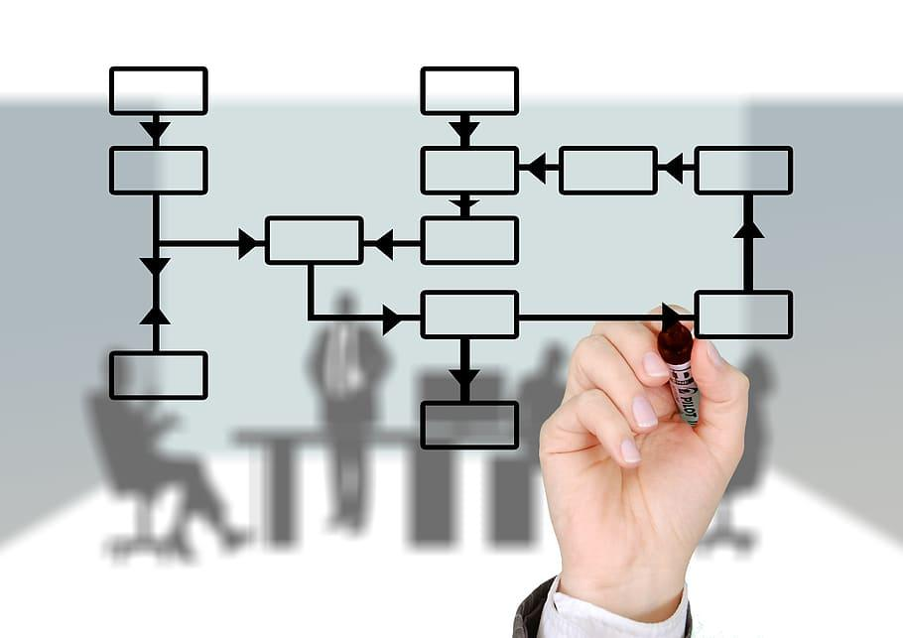
Standardized Process
Process is Defined, Documented, and Measurable
Process is repeatable by different members of the organization
If I remove personnel, the process still functions… adequately
Process can be communicated by members of the team
Value Aligned

Slide 11
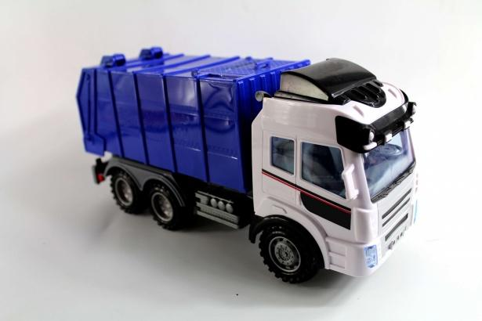
Faster Process (remove waste)
What is waste?
Non-value portions of the process (emergency department)
How do we make processes faster?
Well Scoped Threat Models (reduce unnecessary modeling)
Threat & Mitigations Libraries
Templates
Security Champions (decentralized ownership of security)
Value based reporting

Slide 12

Standardized Tooling
Improves Interoperability
Easier to measure
Transferrable
Single Language for communication
Exchangeable Templates
Env & Architectural Sharing

Slide 13
Freesources (Free + Resources)
Free Platform for Threat Modeling - https://community.iriusrisk.com
OWASP Threat Modeling Cheat Sheet - https://cheatsheetseries.owasp.org/cheatsheets/Threat_Modeling_Cheat_Sheet.html
World’s Shortest Threat Modeling Course - https://www.youtube.com/watch?v=2pvprvsr1lo
Threat Modeling Connect - https://threatmodelingconnect.com

Slide 14
Connect with me
James Rabe
linkedin/in/jrabe3

